Slide 1

TARGET FOLDER
SRNTGT018
Petchenga Research Facility, SRN
SECRET - DCS WORLD
REL TO COALITION
SECRET - DCS WORLD
REL TO COALITION

Slide 2

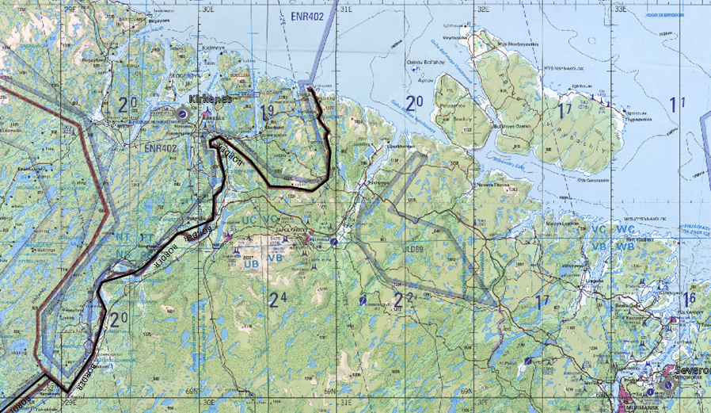
Petchenga Research Facility, SRN
OPAC CLASSIFIED REL TO CJTF-23
JOINT OPERATIONS GRAPHIC [1]
MAP
OVERVIEW
BE: SRNTGT018 CATCODE: 5
MIDB GEO: N 69 31.375 E 031 11.113
ICOD: 2011-FEB-12 DOI:2010-AUG-22
DECL ON: 2061-FEB-11
N
.
Pennchenga Research Facility SRNTGT018

Slide 3
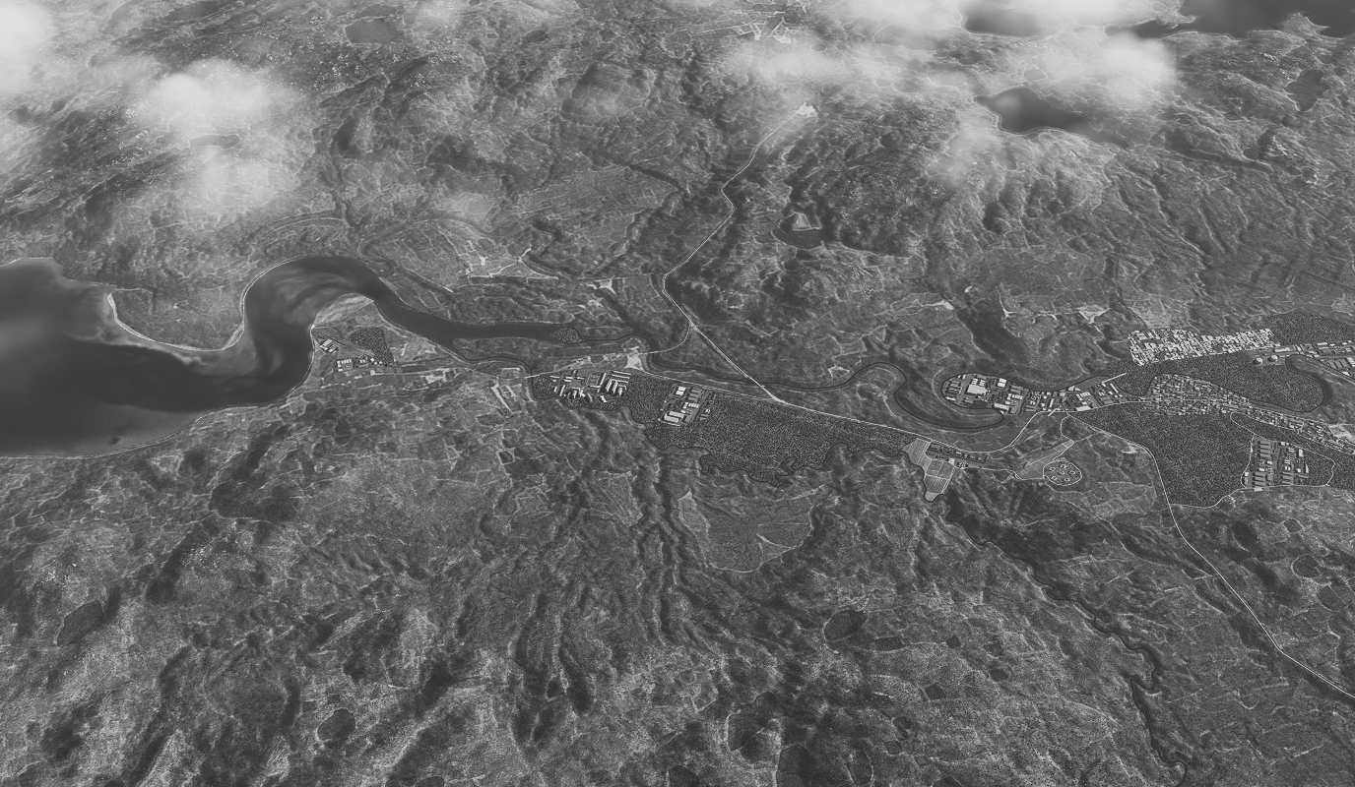
Petchenga Research Facility, SRN
OPAC CLASSIFIED REL TO CJTF-23
FACILITY OUTLINE GRAPHIC 1/1
MAP
OVERVIEW
BE: SRNTGT018 CATCODE: 5
MIDB GEO: N 69 31.375 E 031 11.113
ICOD: 2011-FEB-12 DOI:2010-AUG-22
DECL ON: 2061-FEB-11
N
Petchenga Research Facility
SRNTGT018
SRNTGT032
N:NATO-3-B D:100822 T:1102Z

Slide 4
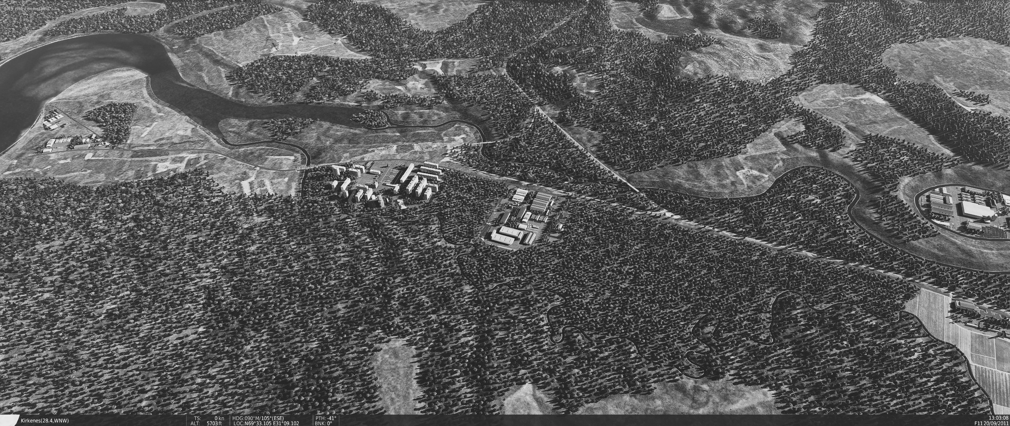
Petchenga Research Facility, SRN
OPAC CLASSIFIED REL TO CJTF-23
DESIRED POINT OF IMPACT GRAPHIC 1/1
MAP
OVERVIEW
BE: SRNTGT018 CATCODE: 5
MIDB GEO: N 69 31.375 E 031 11.113
ICOD: 2011-FEB-12 DOI:2010-AUG-22
DECL ON: 2061-FEB-11
DPI: SRNTGT018-D
SECONDARY RESEARCH FACILITY
N 67 32.646 E 031 11.908
DPI MSL: 75 FT
DPI: SRNTGT018-E
SECONDARY RESEARCH FACILITY
N 67 32.635 E 031 11.928
DPI MSL: 75 FT
N
DPI: SRNTGT018-F
RESEARCH CHEM STORAGE
N 67 32.612 E 031 11.756
DPI MSL: 75 FT
DPI: SRNTGT018-C
POWER TO FACILITY
N 67 32.666 E 031 11.708
DPI MSL: 75 FT
DPI: SRNTGT018-G
FUELSTORAGE
N 67 32.602 E 031 11.721
DPI MSL: 75 FT
DPI: SRNTGT018-A
MAIN RESEARCH FACILITY
N 67 32.622 E 031 11.780
DPI MSL: 75 FT
DPI: SRNTGT018-B
TESTING HALL
N 67 32.656 E 031 11.700
DPI MSL: 75 FT

Slide 5
Petchenga Research Facility, SRN
OPAC CLASSIFIED REL TO CJTF-23
WEAPONEERING OPTIONS 1/1
MAP
OVERVIEW
BE: SRNTGT018 CATCODE: 5
MIDB GEO: N 69 31.375 E 031 11.113
ICOD: 2011-FEB-12 DOI:2010-AUG-22
DECL ON: 2061-FEB-11
DPI | DESCRIPTION | TLE | WARHEAD | GUIDANCE | DESIRED EFFECT | IMPACT ANGLE | FUZING
A | MS CONCRETE LAB/OFFICE BUILDING | CAT 3 | 2000 lbs | METRIC | BLAST | 60-90 | 25ms
B | SS STEEL CLAD WAREHOUSE | CAT 3 | 1000 lbs | METRIC | BLAST | 60-90 | 10ms
C | POWER DISTRIBUTION BRICK HOUSE | CAT 3 | 500lbs | METRIC | BLAST | 60-90 | 10ms
D,E | MS BRICK LAB/OFFICE BUIDLING | CAT 3 | 1000lbs | METRIC | BLAST | 60-90 | 10ms
F,G | REVETTED LIQUID/GAS STORAGE | CAT 3 | 1000lbs | METRIC | BLAST | 60-90 | 0ms

Slide 6
Petchenga Research Facility, SRN
OPAC CLASSIFIED REL TO CJTF-23
COLLATERAL DAMAGE ESTIMATION GRAPHIC 1/1
MAP
OVERVIEW
BE: SRNTGT018 CATCODE: 5
MIDB GEO: N 69 31.375 E 031 11.113
ICOD: 2011-FEB-12 DOI:2010-AUG-22
DECL ON: 2061-FEB-11
N
CER 250M / 812FT
NCC: RESIDENTIAL AREA
DPI A
DPI E
CDE5, CIVILIAN RESIDENTIAL AREA INSIDE 800ft.

Slide 7
Petchenga Research Facility, SRN
OPAC CLASSIFIED REL TO CJTF-23
COLLATERAL DAMAGES ESTIMATION 1/1
MAP
OVERVIEW
BE: SRNTGT018 CATCODE: 5
MIDB GEO: N 69 31.375 E 031 11.113
ICOD: 2011-FEB-12 DOI:2010-AUG-22
DECL ON: 2061-FEB-11
COLLATERAL DAMAGES WITHIN A 500M RADIUS
DESCRIPTION |  | CATCODE | MIDB GEOS | LOCATION | REMARKS
NO STRIKE ENTITIES WITHIN A 500M RADIUS
NSE ID | DESCRIPTION | CATCODE | MIDB GEOS | LOCATION | REMARKS

Slide 8
Petchenga Research Facility, SRN
OPAC CLASSIFIED REL TO CJTF-23
BATTLE DAMAGE ASSESSMENT GRAPHIC 1
MAP
OVERVIEW
BE: SRNTGT018 CATCODE: 5
MIDB GEO: N 69 31.375 E 031 11.113
ICOD: 2011-FEB-12 DOI:2010-AUG-22
DECL ON: 2061-FEB-11
POST-STRIKE
PRE-STRIKE
N
TARGET OBJECTIVE
DAMAGE/CHANGE ASSESSMENT
DPI:[XXXXXX]
BDA REMARK: [CLASSIFICATION] [DISSEMINATION] Assessment: Physical Damage/change, Collateral Damage, Functional Damage/change, Munitions Effectiveness, Reattack Recommendation, Additional/Collateral Effects

Slide 9

ACRONYMS
ACRONYM | MEANING | DEFINITION
BE | Basic Encyclopedia Number | Alpha/numeric code unique to an installation for incorporation within various national and tactical systems.
CATCODE | Category Code | The data Element that classifies the function and purpose of an installation or a facility.
MIDB | Modernized Integrated Database | A database comprised of information on facilities of military significance, military forces, and related equipment.
ICOD | Intelligence Cut Off Date | The date of the latest intelligence data inputted to a feature.
DOI | Date of Image | Date on which a geospatial or intelligence-related image was captured.
CE | Critical Element | An element of an entity or object that enables it to perform its primary function.
PV CHAR | Physical Vulnerability Characteristic | Standardized alphanumeric code describing the physical and structural properties of a target.
JDPI | Joint Desired Point of Impact | A unique, alphanumeric coded aimpoint identified by a three dimensional mensurated point. It represents a weapon or capability desired point of impact or penetration.
CE90 | Circular Error at 90% | 90 percent confidence level in the horizontal plane.
LE90 | Linear Error at 90% | 90 percent confidence level in the vertical dimension
MSL | Mean Sea Level | Elevation above Earth reference geoid.
AGL | Above Ground Level | Elevation above ground surface.
NCC | Nearest Collateral Concern | Closest non-targeted structure, area, or entity near a planned point of impact that may be at risk of unintended damage during a military strike.
CER | Collateral effects radius | Radius within which collateral damage might happen based on the weapon's characteristics, the target environment, and other operational factors.
CDE | Collateral damage estimate | Systematic process used in military targeting to evaluate the potential for unintended damage or harm to non-combatant entities, structures, or personnel as a result of a planned strike.
NSE | No Strike Element | Specific entities, locations, or objects that are protected from intentional targeting under the Law of Armed Conflict (LOAC) or by operational policy.

